Slide 1

Computer Organization & Assembly Language(CS-215T)
Lecture by:
Mr. Shakir Karim
Assistant Professor
DoCS&IT, SSUET
Batch 2022F

Slide 2
Week 3
Assembly Language programming, Data Directives, Instructions and Operands Types
Computer Science & Information Technology Department
Sir Syed University of Engg. & Tech.
Lecture by: Mr. Shakir Karim

Slide 3
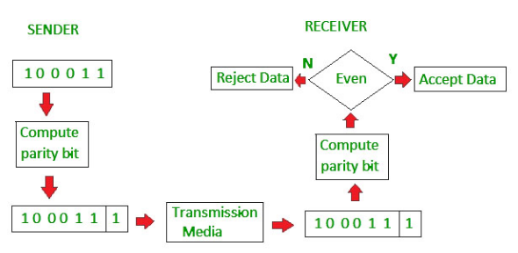
Parity Flag
Even Parity System
If even number of 1’s then 0 is added
Else 1 is added
Computer Science & Information Technology Department
Sir Syed University of Engg. & Tech.
Lecture by: Mr. Shakir Karim

Slide 4
Zero Flag
Used to check whether the answer is zero or not
Set, if answer is zero
Clear, if answer is not zero
Computer Science & Information Technology Department
Sir Syed University of Engg. & Tech.
Lecture by: Mr. Shakir Karim

Slide 5
Auxiliary Flag
Used in BCD arithmetic only
Set, if a carry is generated from bit#3 (fourth bit)
to bit#4 (fifth bit)
Computer Science & Information Technology Department
Sir Syed University of Engg. & Tech.
Lecture by: Mr. Shakir Karim

Slide 6
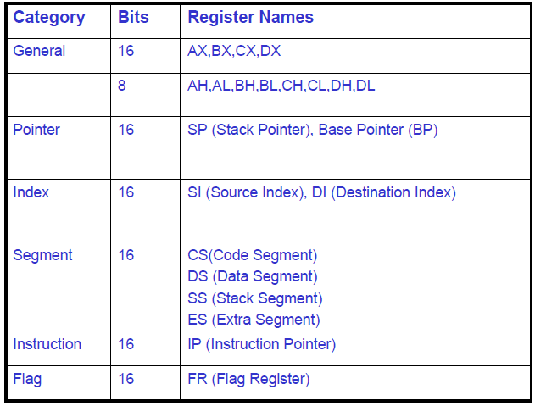
8086/88 Registers Details
Computer Science & Information Technology Department
Sir Syed University of Engg. & Tech.
Lecture by: Mr. Shakir Karim

Slide 7
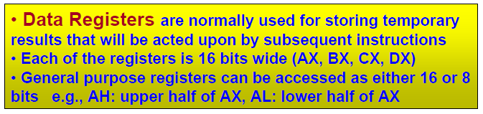
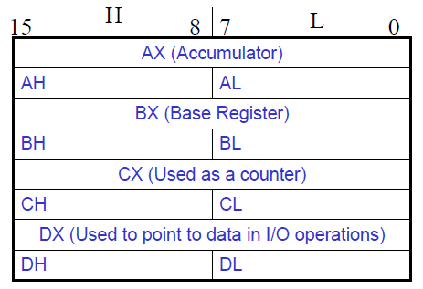
8086/88 General Purpose Registers
Computer Science & Information Technology Department
Sir Syed University of Engg. & Tech.
Lecture by: Mr. Shakir Karim

Slide 8
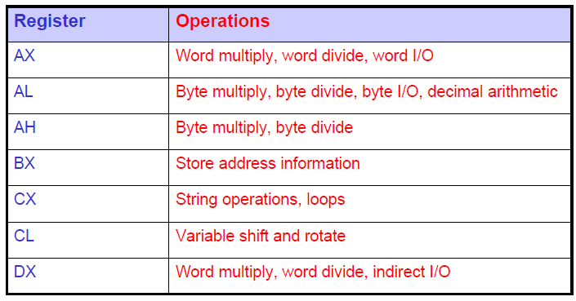
8086/88 Data Registers
Computer Science & Information Technology Department
Sir Syed University of Engg. & Tech.
Lecture by: Mr. Shakir Karim

Slide 9
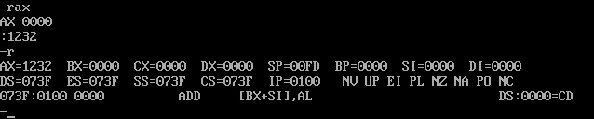
8086/88 Data Registers/2
Computer Science & Information Technology Department
Sir Syed University of Engg. & Tech.
Lecture by: Mr. Shakir Karim

Slide 10
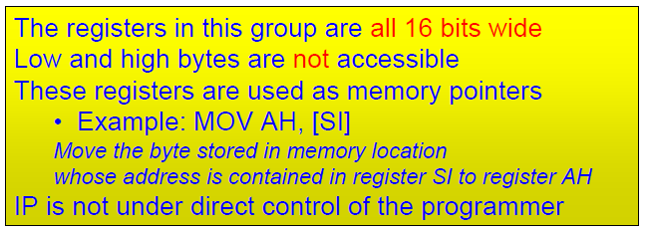
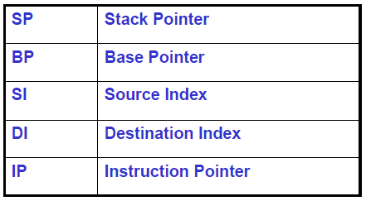
8086/88 Pointer & Index Registers
Computer Science & Information Technology Department
Sir Syed University of Engg. & Tech.
Lecture by: Mr. Shakir Karim

Slide 11
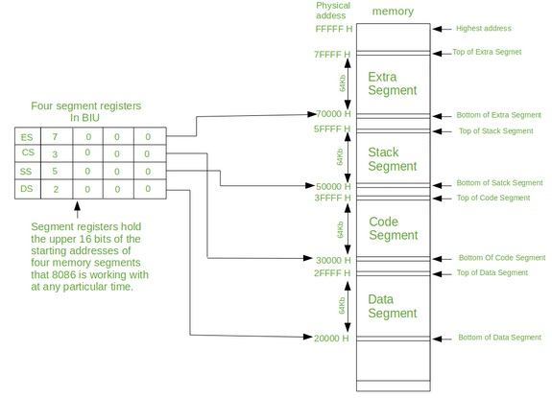
8086/88 Segment Registers
Computer Science & Information Technology Department
Sir Syed University of Engg. & Tech.
Lecture by: Mr. Shakir Karim

Slide 12
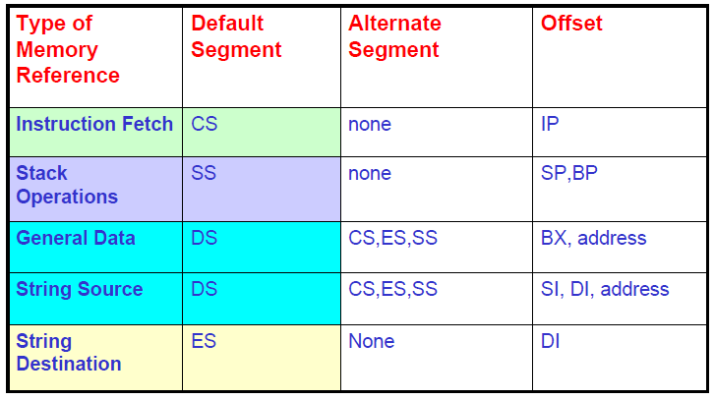
8086/88 Segment Registers Assignment
Computer Science & Information Technology Department
Sir Syed University of Engg. & Tech.
Lecture by: Mr. Shakir Karim

Slide 13
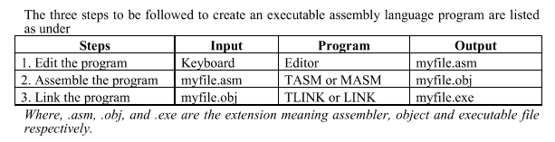
8086/88 Assembly Language
Computer Science & Information Technology Department
Sir Syed University of Engg. & Tech.
Lecture by: Mr. Shakir Karim

Slide 14
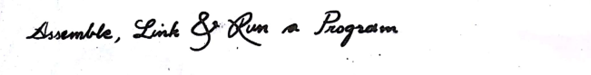
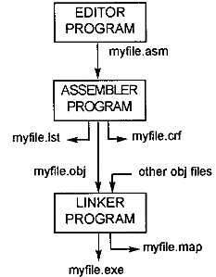
8086/88 Assembly Language
Computer Science & Information Technology Department
Sir Syed University of Engg. & Tech.
Lecture by: Mr. Shakir Karim

Slide 15
Number of Fields in Assembly Language Program
There are four fields
[label:]
mnemonics
[operands]
[;comments]
Brackets indicate that the field is optional
ADD AX, BX ; AX = AX+BX
NOP ; no operation
Computer Science & Information Technology Department
Sir Syed University of Engg. & Tech.
Lecture by: Mr. Shakir Karim

Slide 16
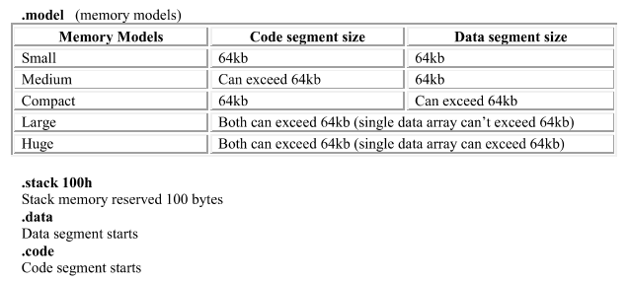
Directives in Assembly Language Program
Directives are used by assembler only
NO machine code is generated for directives
Computer Science & Information Technology Department
Sir Syed University of Engg. & Tech.
Lecture by: Mr. Shakir Karim

Slide 17
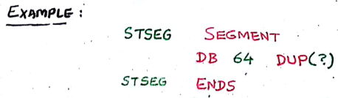
Directives in Assembly Language Program/2
Segments of a programs are defined using
SEGMENT to start a segment
ENDS to end a segment
Defining Stack Segment
Computer Science & Information Technology Department
Sir Syed University of Engg. & Tech.
Lecture by: Mr. Shakir Karim

Slide 18
Directives for Data Types in Assembly Language Program
Org(Origin) indicates beginning of offset
DUP(Duplicate)
EQU(Equate)
DB (Define Byte) allocates memory in bytes
DW(Define Word) allocates memory in words
Similarly
DD (Define Doubleword)
DQ (Define Quadword)
DT (Define Ten bytes)
Computer Science & Information Technology Department
Sir Syed University of Engg. & Tech.
Lecture by: Mr. Shakir Karim

Slide 19
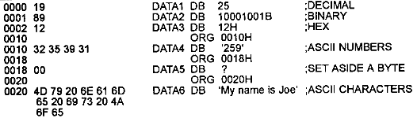
Directives for Data Types in Assembly Language Program/2
Example of DB directive
Computer Science & Information Technology Department
Sir Syed University of Engg. & Tech.
Lecture by: Mr. Shakir Karim

Slide 20
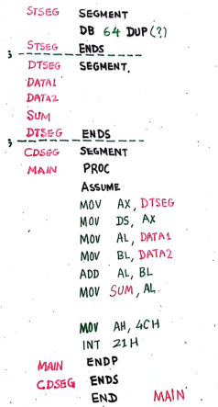
Form of an
Assembly Language Program
Computer Science & Information Technology Department
Sir Syed University of Engg. & Tech.
Lecture by: Mr. Shakir Karim

Slide 21
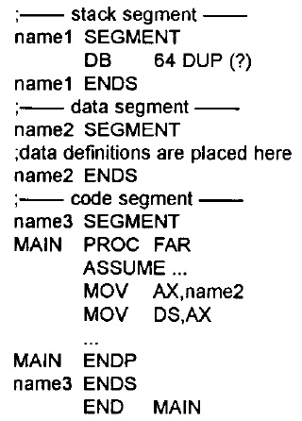
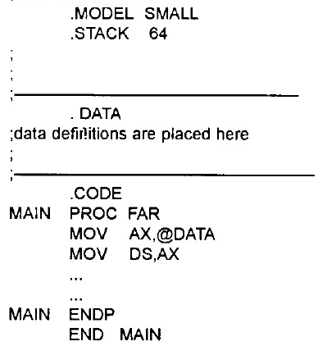
Form of an
Assembly Language Program/2
Full Segment Definition
Simplified Segment Definition
Computer Science & Information Technology Department
Sir Syed University of Engg. & Tech.
Lecture by: Mr. Shakir Karim

Slide 22
Further Reading
Carefully read pages
50 to 62 and 68 to 75
from Chapter 2 of
The 80x86 IBM PC and Compatible Computers (Vol. I & II) Assembly Language, Design, and Interfacing (4th Ed.) by Muhammad Ali Mazidi and Janice Gillispie Mazidi Pearson Education, Inc. Upper Saddle River, New Jersey 07458
Must read and try to understand
Analysis of Programs 2.1 and 2.2 (pg 58 to 61)
Computer Science & Information Technology Department
Sir Syed University of Engg. & Tech.
Lecture by: Mr. Shakir Karim

